Slide 1
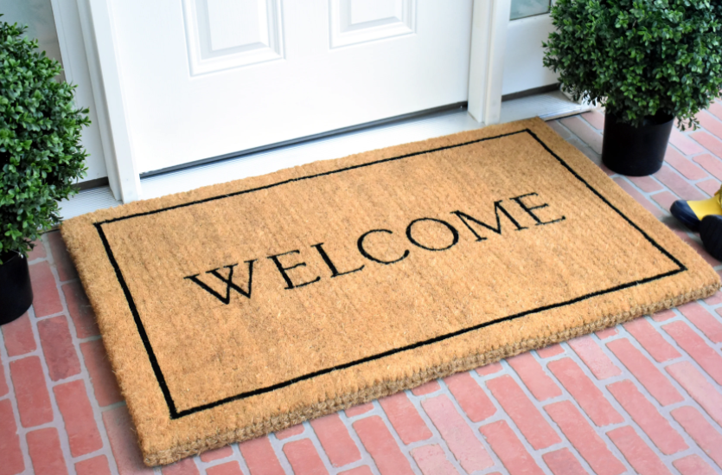
to my presentation

Slide 2
Predicate Logic
Theory
Computational Logic

Slide 3
Predicate Logic
Theory

Slide 4
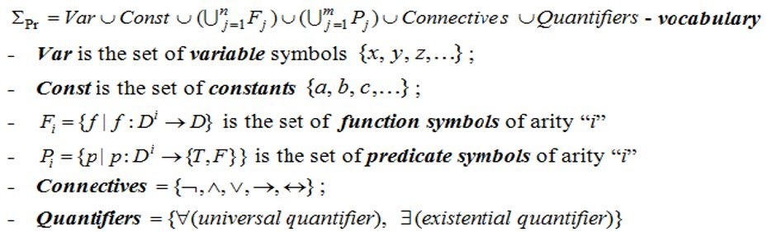
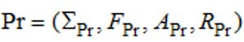
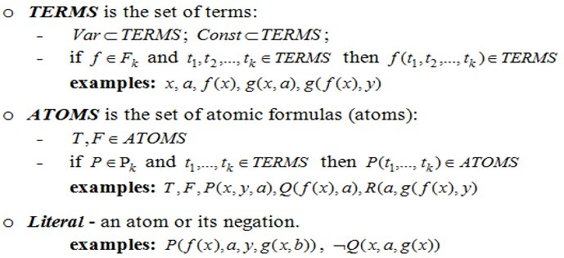
AXIOMATIC SYSTEM OF PREDICATE LOGIC (STRUCTURE OF PREDICATE FORMULAS)
Theory
Predicate Logic

Slide 5
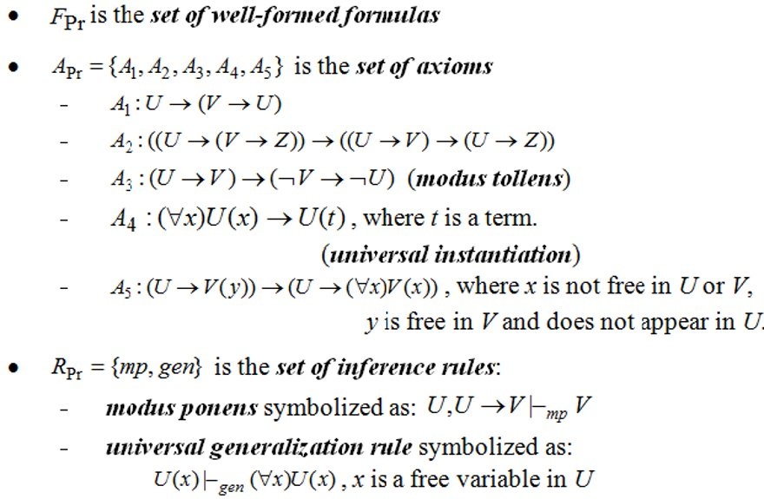
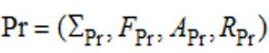
AXIOMATIC SYSTEM OF PREDICATE LOGIC (STRUCTURE OF PREDICATE FORMULAS)

Slide 6
Exercises

Slide 7
Predicate Logic
Exercises
Exercise 2
Transform the following statements from natural language into predicate formulas choosing the appropriate constants, function symbols and predicate symbols:
2.1 Every student who makes good grades is brilliant or studies.
2.8 Every investor who bought something that falls is not happy.

Slide 8
Predicate Logic
2.1 Every student who makes good grades is brilliant or studies.
D = the set of all students
G : D -> { T, F }, G(x) = T if x gets good grades
B : D -> { T, F }, B(x) = T if x is brilliant
ST : D->{ T, F }, ST(x) = T if x studies
(⩝x)(G(x)->B(x) v ST(x))

Slide 9


Slide 10



Predicate Logic
2.8 Every investor who bought something that falls is not happy.
D = set of all investors
DOGE : D -> { T, F }, DOGE(x) = T if x bought something that falls
NH : D -> { T, F }, NH(x) = T if x is not happy
(⩝x) (DOGE(x)->NH(x)
wallstreetbets
r/wallstreetbets

Slide 11

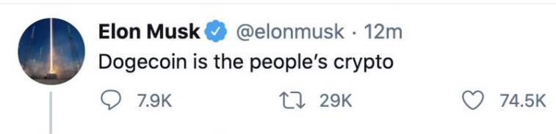
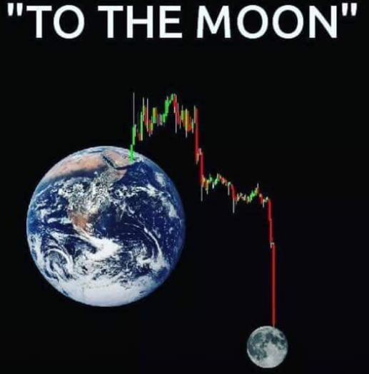
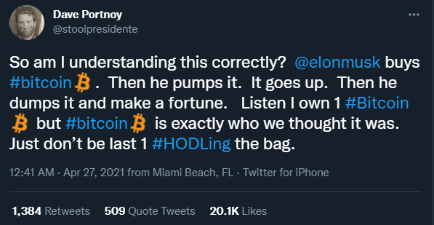
A story told in two parts:

Slide 12
thank

Slide 13
Donda
by Kanye West

